Slide 1
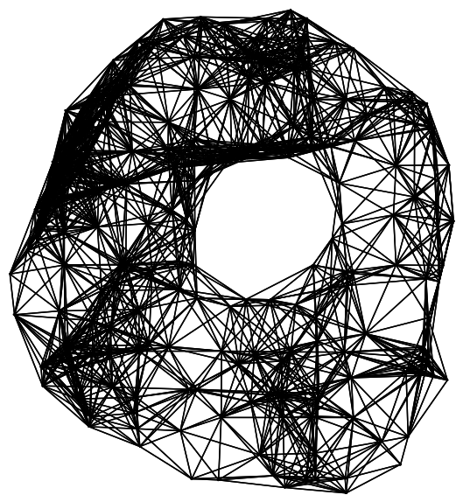
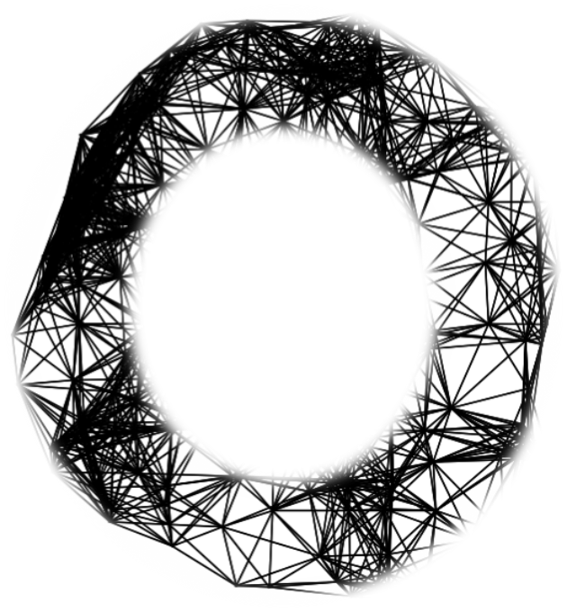
Computation of Persistent Homology Using the Delaunay-Rips Complex
An efficient family of simplicial complexes
for topological data analysis
Amish Mishra and Francis Motta

Slide 2
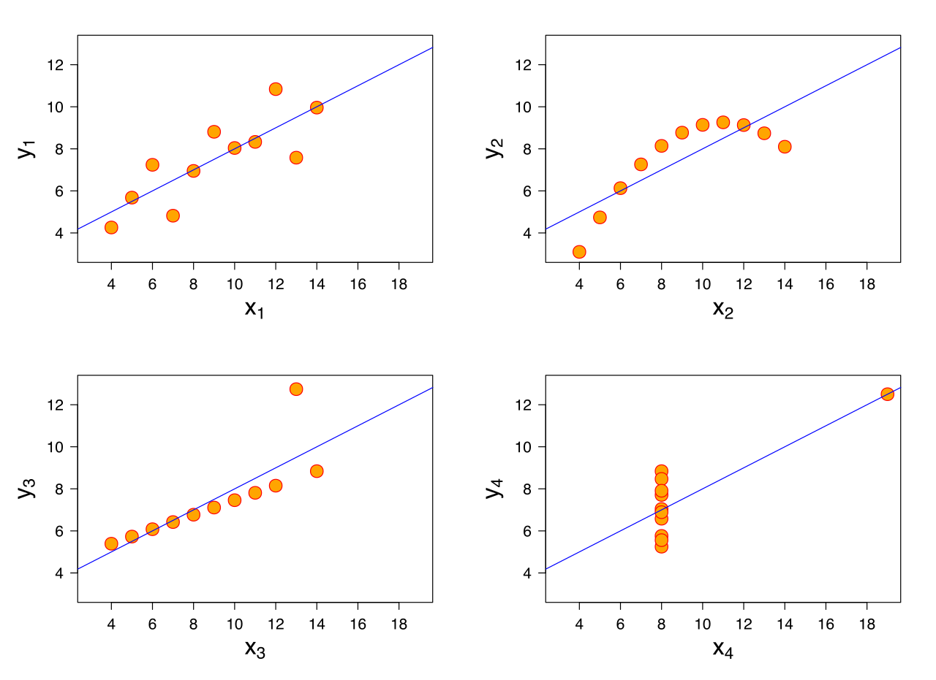
Anscombe’s Quartet
Figure 1: "File:Anscombe.svg." Wikimedia Commons, the free media repository. 13 Sep 2020, 11:05 UTC. 26 Oct 2021, 15:08 <https://commons.wikimedia.org/w/index.php?title=File:Anscombe.svg&oldid=457710151>.
Notes:
Similar mean of x, y, sample variance of x and y, correlation, linear regression, R^2

Slide 3
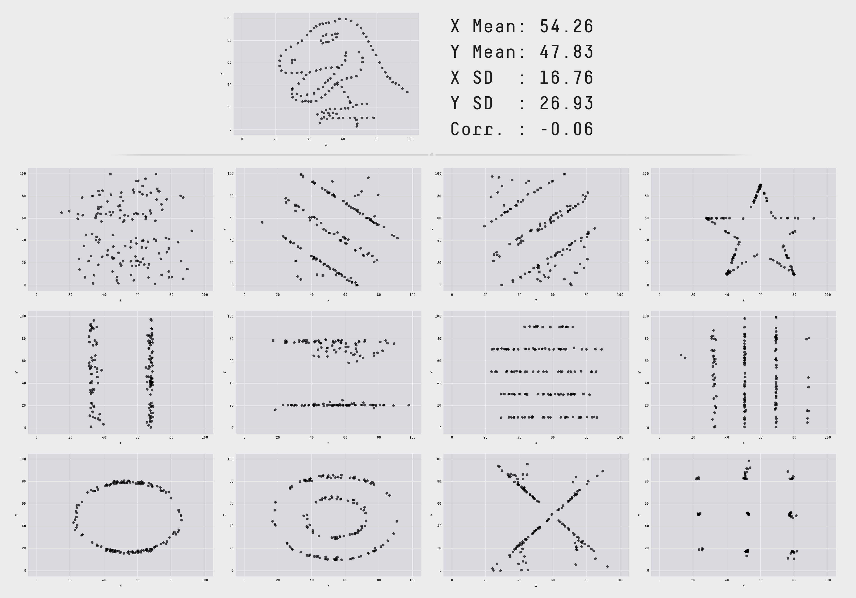
The Datasaurus Dozen
Notes:
https://www.autodesk.com/research/publications/same-stats-different-graphs

Slide 4
Problem

Slide 5
Problem
What if visualization is not an option?

Slide 6
TDA

Slide 7
TDA (Topological Data Analysis)
Quantify the qualitative features of data for computation and statistical analysis

Slide 8
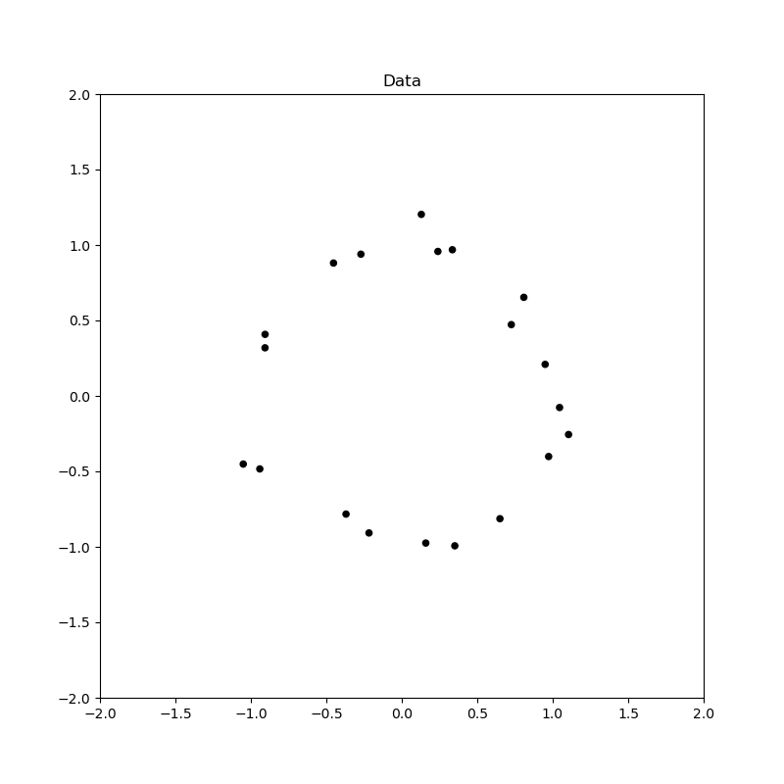
TDA (Topological Data Analysis)

Slide 9
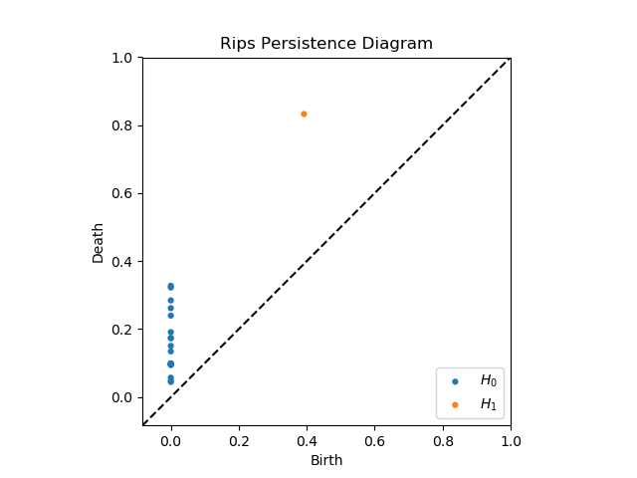
TDA (Topological Data Analysis)

Slide 10
TDA Applications
Protein folding video
Mobile data: https://epjdatascience.springeropen.com/articles/10.1140/epjds/s13688-015-0041-5
Brain arteries:
https://cdr.lib.unc.edu/concern/parent/c534fv18f/file_sets/ft848x10p
Notes:
PersGNN Krishnapriyan

Slide 11
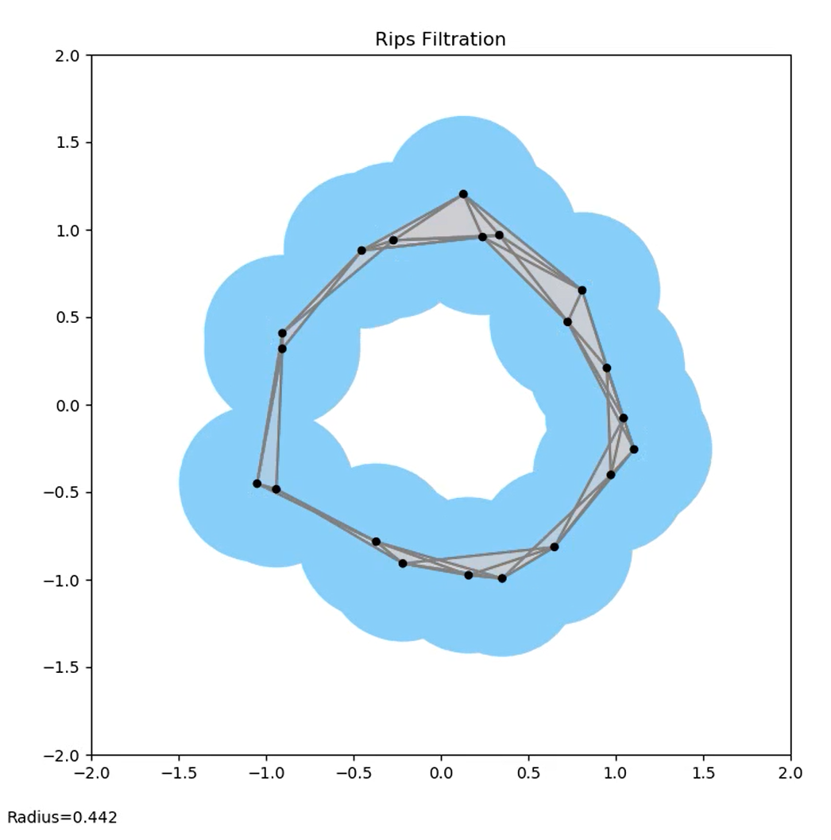
Pipeline
Data
Persistence Diagram
Interpretation
Complex
One significant loop in the data

Slide 12
Current Work

Slide 13
Buzz words
Data/Point cloud
picture

Slide 14
Buzz words
Complex/Topology
Picture

Slide 15
Buzz words
Persistence Diagram/Geometric Features
Picture of PD with complex to show correspondence

Slide 16
Motivation
We want to improve computation efficiency

Slide 17
Rips

Slide 18
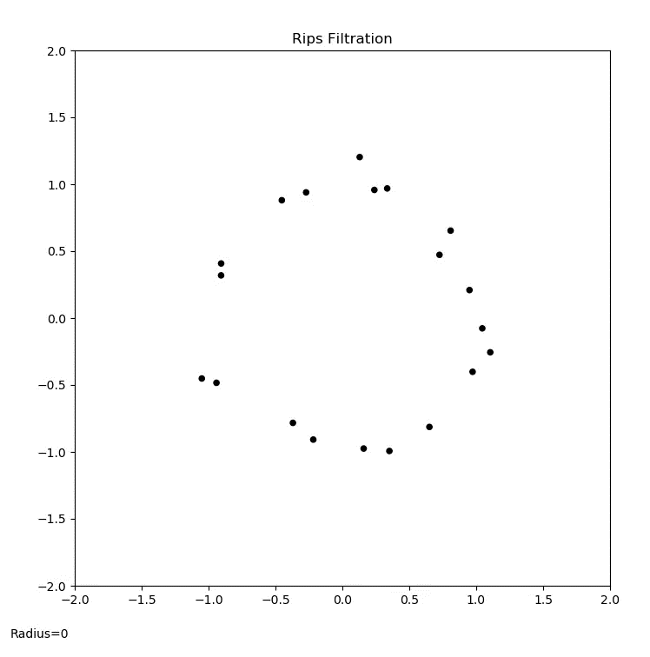
Rips animation

Slide 19
PD Interpretation

Slide 20
Idea
Reduce the number of simplices

Slide 21
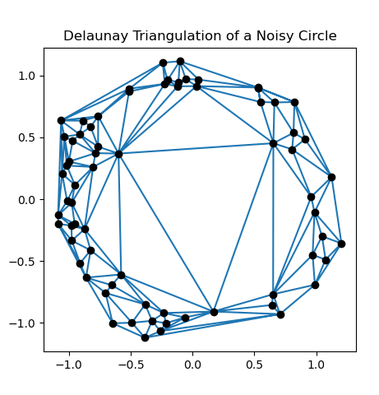
Delaunay Triangulation

Slide 22
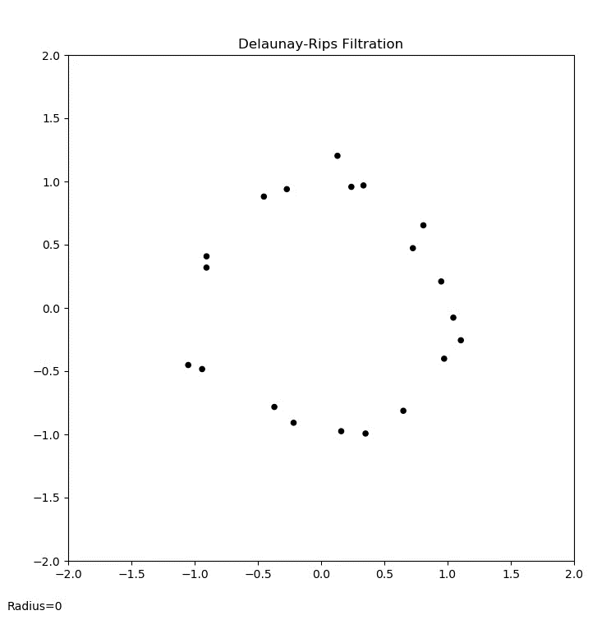
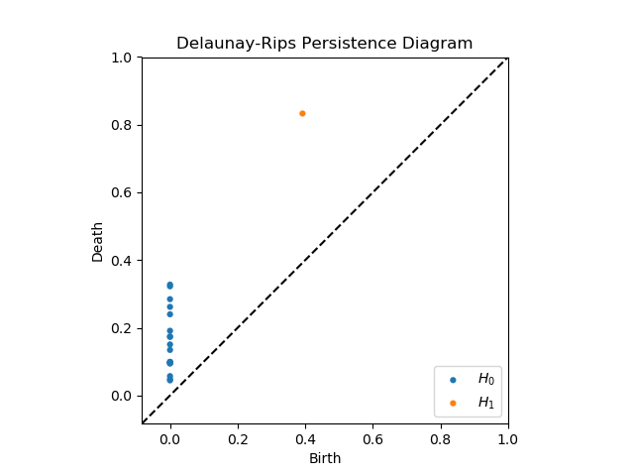
Del-Rips animation

Slide 23

PD Interpretation

Slide 24
Persistence diagram comparison

Slide 25
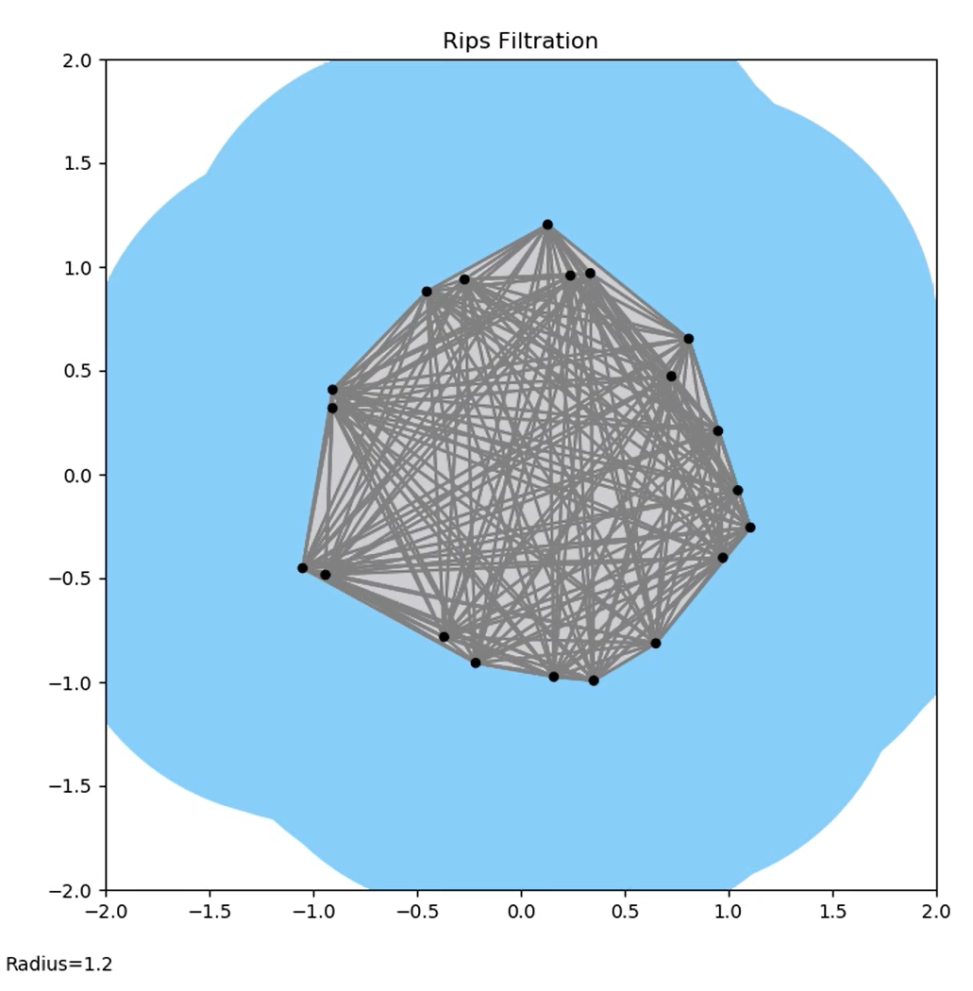
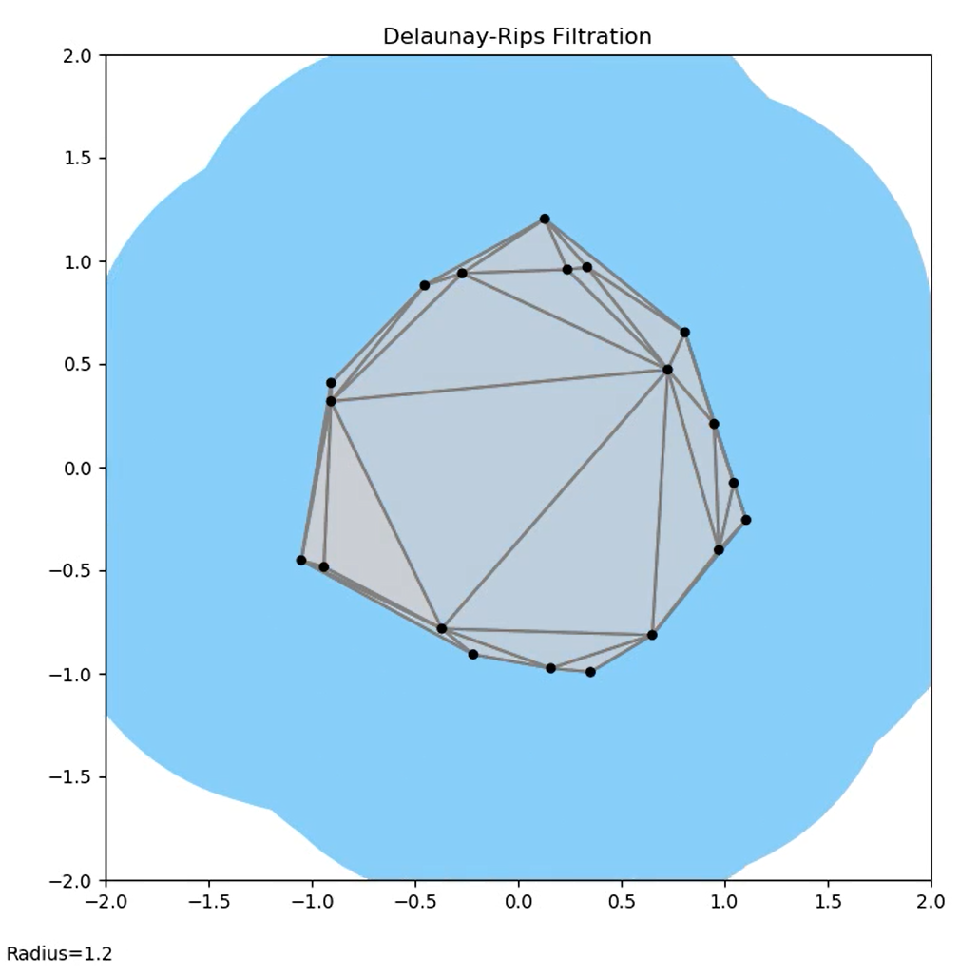
Complex Comparison

Slide 26
Run-time comparison

Slide 27
Synthetic Data application

Slide 28
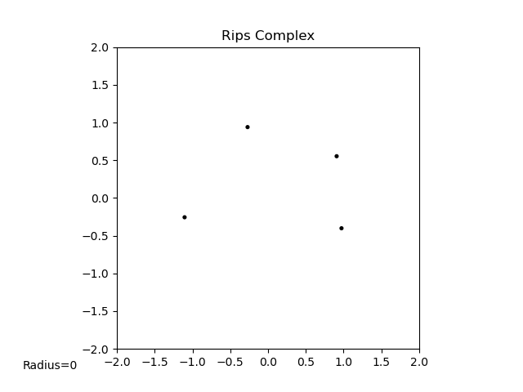
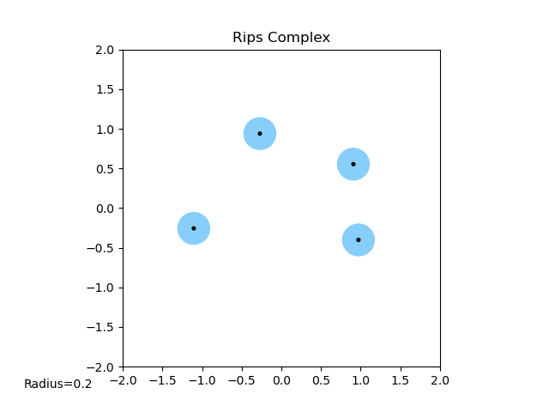
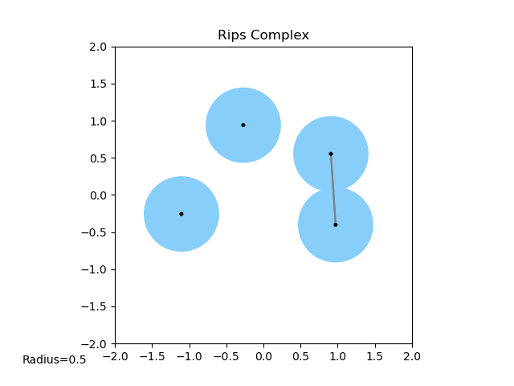
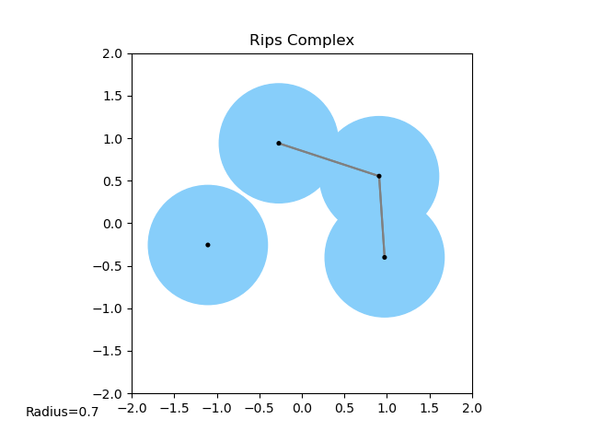
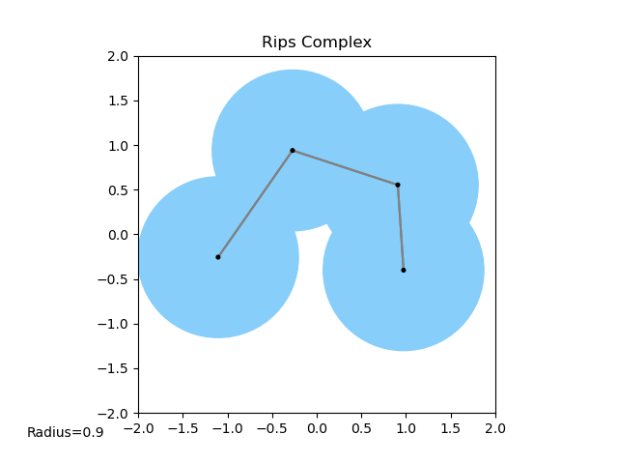
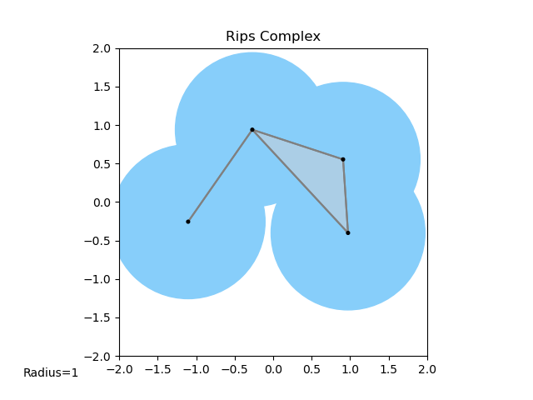
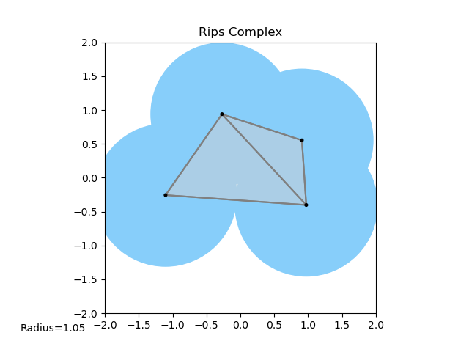
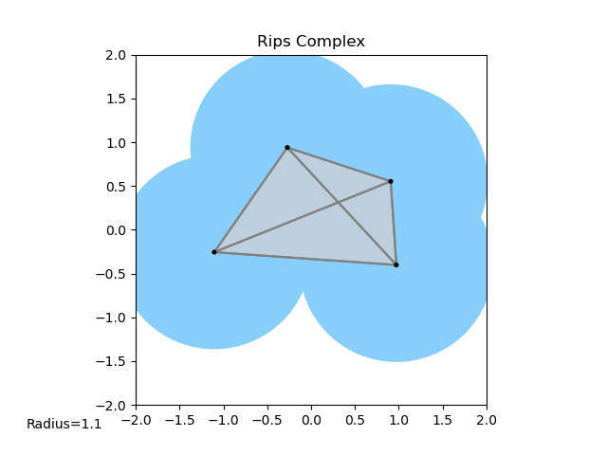
Definition of Rips

Slide 29
Definition of Delaunay Triangulation

Slide 30
Definition of Delaunay-Rips complex

Slide 31
Definition of filtration

Slide 32
Algorithm for building filtration

Slide 33
Question: How stable is this?

Slide 34
Video of instability

Slide 35
Definition: GH distance

Slide 36
Definition: Bottle-neck distance

Slide 37
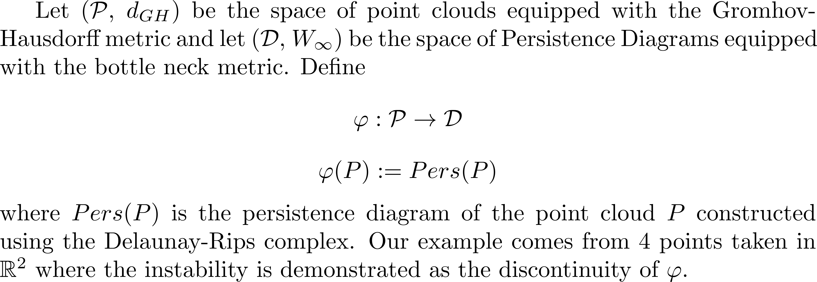
Math behind instability

Slide 38
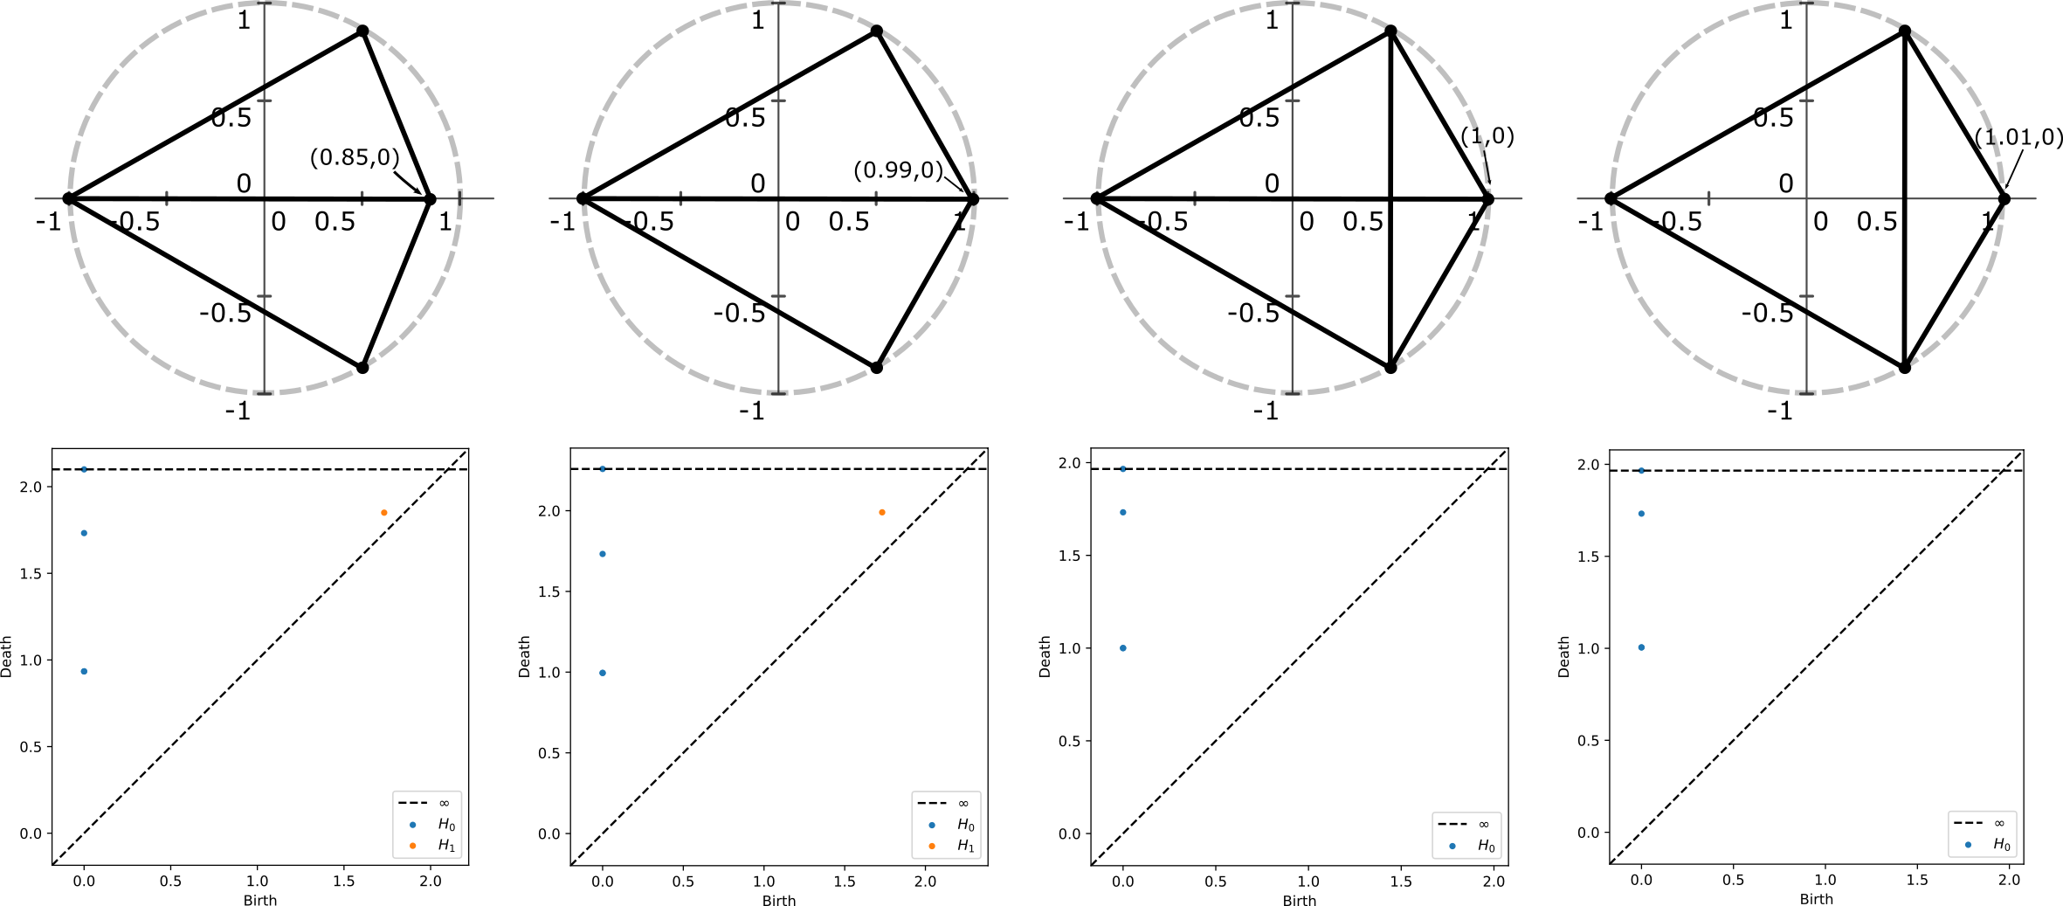

Slide 39
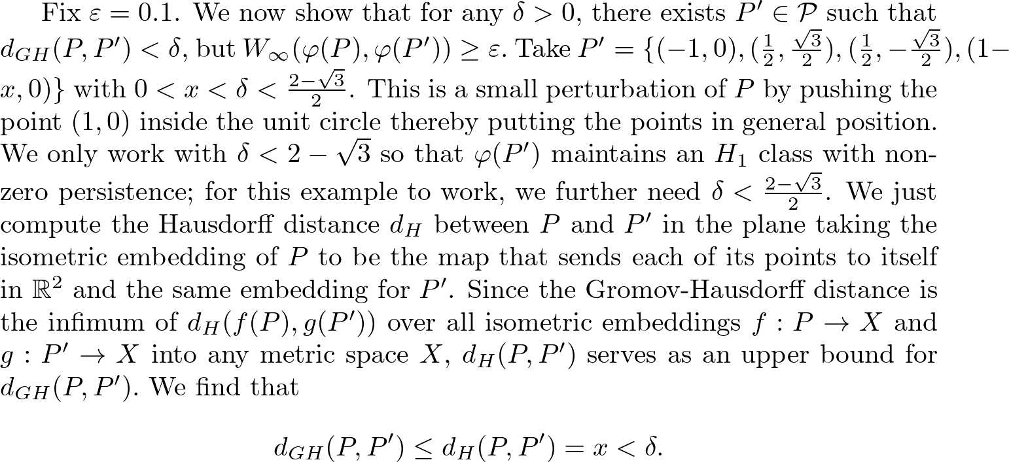

Slide 40
Visual 4 pt example of instability

Slide 41
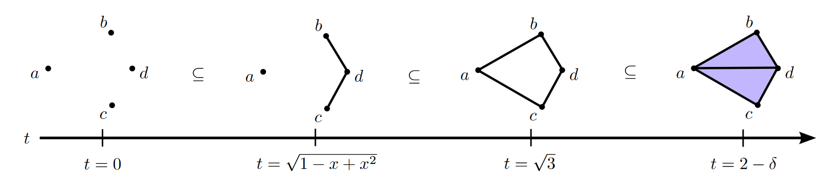
Lemma

Slide 42
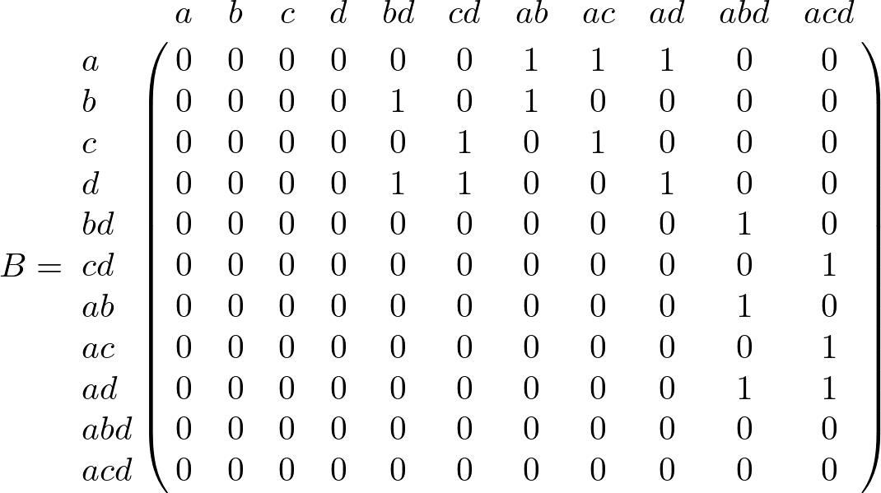

Slide 43
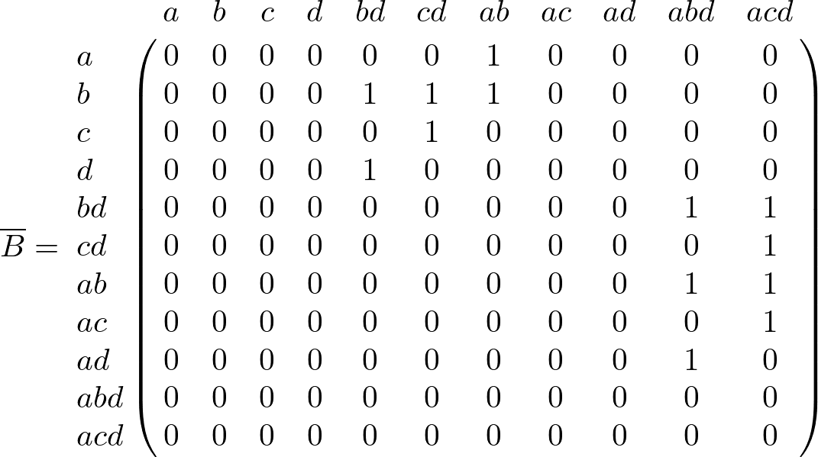

Slide 44
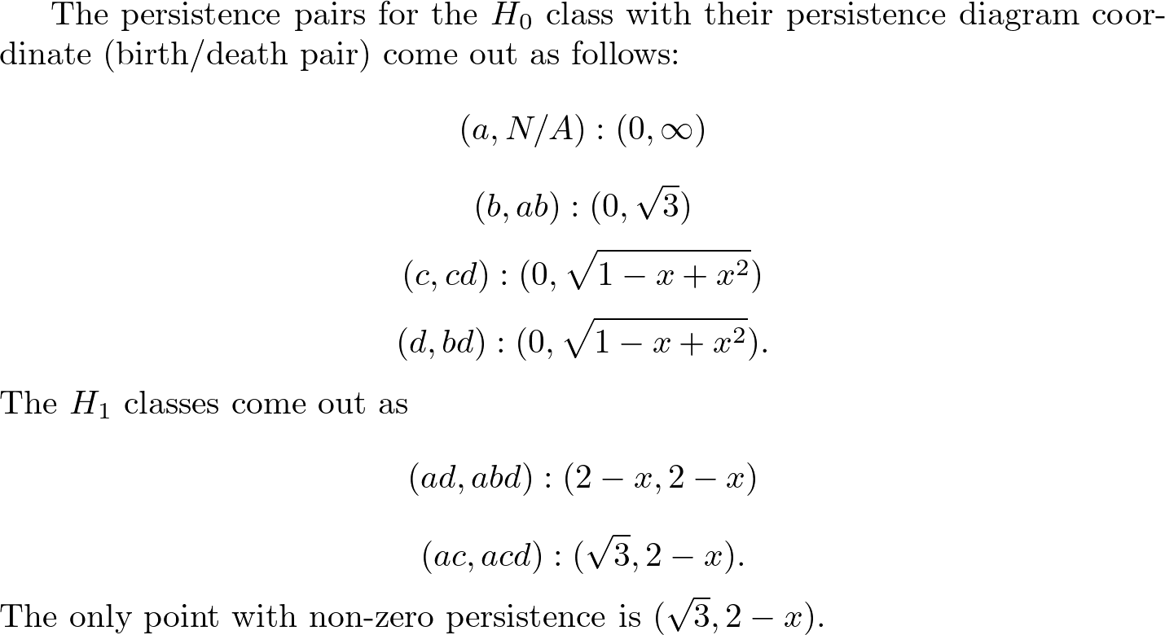

Slide 45
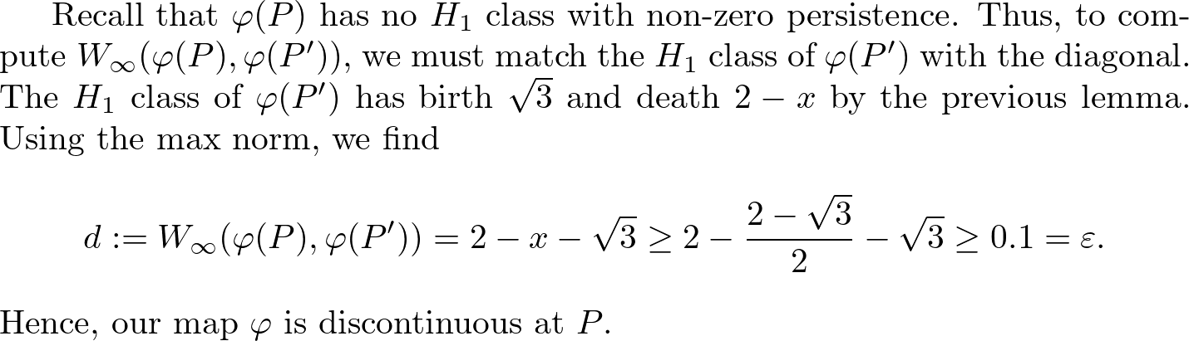

Slide 46
Conditions that guarantee stability
Theorem
Lemmas
Ideas behind lemma
Visuals of circumcenter moving and causing edge-flips in triangulation
Show when a Delaunay face exists and when it doesn’t
R^2 examples

Slide 47
Maintain Delaunay Triangulation!

Slide 48
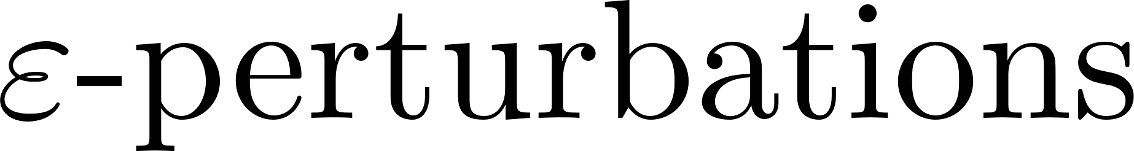
Existing work (Weller)

Slide 49
Apply to real data sets

Slide 50
Applications in ML

Slide 51
Proving stability for other TDA methods

Slide 52
Acknowledgements
Francis Motta
FAU
JMM

Slide 53
References

